Slide 1
Interactive Visual Data Analysis
03 – Process models

Slide 2
Objectives
Illustrate influencing factors (see previous lecture) with an example
Learn about models for
The design of interactive visual data analysis solutions
The transformation of data to visual representations
The generation of knowledge via interactive visual data analysis

Slide 3
Overview
Example visualization of meteorological data
Process models
Design process
Data transformation process
Knowledge generation process

Slide 4
Influencing factors: Example
The data:
Meteorological times series (T → A) with air temperature, air pressure, wind speed, hours of sunshine, cloud cover, precipitation, precipitation type, etc.
Values are scalars with continuous, discrete and nominal scale (e.g., continuous air temperature, discrete hours of sunshine, nominal prec. type)
Data size: 23,725 daily measurements (about 65 years), the dimension of time as 1 independent variable, 10 attributes as dependent variables
The (simplified) context:
Single user on regular computer display with mouse and keyboard
Application related to climate research, but no particular domain conventions

Slide 5
Influencing factors: Example
The task:
Goal: Explore
Analytic question: Are there any patterns corresponding to seasonal variations?
Target: Synoptic nature of question requires us to look at all data tuples, but we want to concentrate on hours of sunshine, air temperature, and cloud cover
Means: Visual representation via dot plots

Slide 6
Influencing factors: Example
Hours of sunshine
Note that only day and month of dates are considered, not the year (projection).
Peak at summer solstice as expected

Slide 7
Influencing factors: Example
Air temperature lags behind sunshine duration by about one month (seasonal lag)
Air temperature
Nothing exciting so far, but finding the expected gives credence to validity of the data and expressiveness of the visual representation.

Slide 8
Influencing factors: Example
Cloud cover
Think about: Anything to see here?
(*) Noticed this horizontal line?!
Fewer days with less cloud cover in the colder season.
Notes:
Horizontal stripes slightly above 50/80!

Slide 9
Influencing factors: Example
Cloud cover
Because of (*), we change our task from exploring seasonal trends to describing the unexpected finding
It is located slightly above 50/80 at approx. 52/80
Next, we aim at explaining the finding and switch to a different visual representation, namely a histogram
Notes:
Horizontal stripes slightly above 50/80!

Slide 10
Influencing factors: Example
Cloud cover histogram
A histogram visualizes the frequency of data values
Per possible value of cloud cover (0,..,81) we see how many days have a particular value
Obviously, there is indeed a dip at 52/80
Another dip can be found at 12/80
Notes:
Horizontal stripes slightly above 50/80!

Slide 11
Influencing factors: Example
Cloud cover histogram
Finally, we want to confirm that we found something relevant
We look for at data from a different station
We now see dips for all x2 (2, 12, 22, etc.) values
Conclusion: We need to carry out further analysis in collaboration with domain experts to find the cause of these dips (maybe sensor problem)
Notes:
Horizontal stripes slightly above 50/80!

Slide 12
Process models
That concludes our discussion of influencing factors
Let’s continue with process models

Slide 13
Process models
Roles and processes
Designer: Devise the design of visual representations and interactions
Developer: Implement the data’s transformation to interactive visual representations
User (or analyst): Analyze the data for the generation of knowledge
Consequently, we will look at 3 processes
Design process
Data transformation process
Knowledge generation process

Slide 14
The design process
Designing interactive visual data analysis solution is challenging
Key difficulty is to come up with an appropriate ensemble of visual, interactive, and computational means that work together to help people solve data analysis problems
To help structure the design process, Munzner (2009) proposed a
Nested Model for Visualization Design and Validation

Slide 15
The design process
Nested Model
4 nested levels of design and validation
Domain characterization
Data and task abstraction
Design conceptualization
Solution implementation

Slide 16
The design process
Nested Model
Domain characterization (The context)
Familiarize with application domain
Understand the users and their domain-specific problems
Consider the working environment and the applied tools
Involving domain experts is highly recommended!
Data and task abstraction (The data and the tasks)
Map domain-specific description to the language of interactive visual data analysis
Determine essential data and tasks
Focus on conceptually relevant aspects and abstract from domain details

Slide 17
The design process
Nested Model
Design conceptualization
Define overall solution
Combine visual, interactive, and computational components
Find expressive visual encodings, useful interactive tools, and potent computing procedures that match the abstracted data and tasks
Design methodology: Five Design-Sheets by Roberts et al. (2017)
Five sheets
Five parts per sheet
Five parts to the process

Slide 18
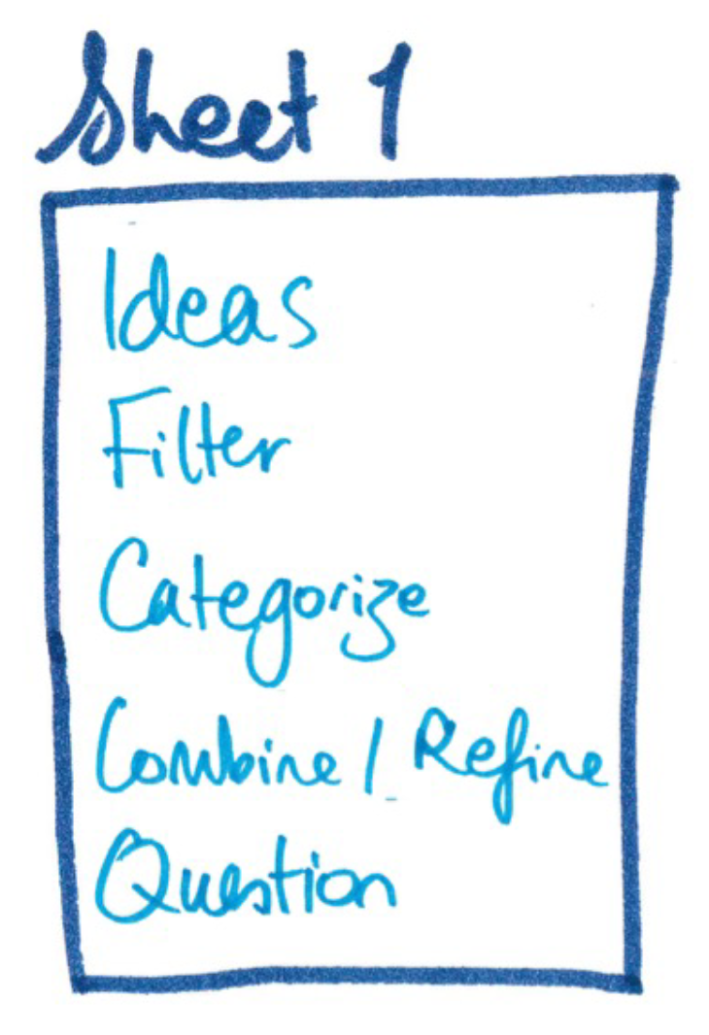
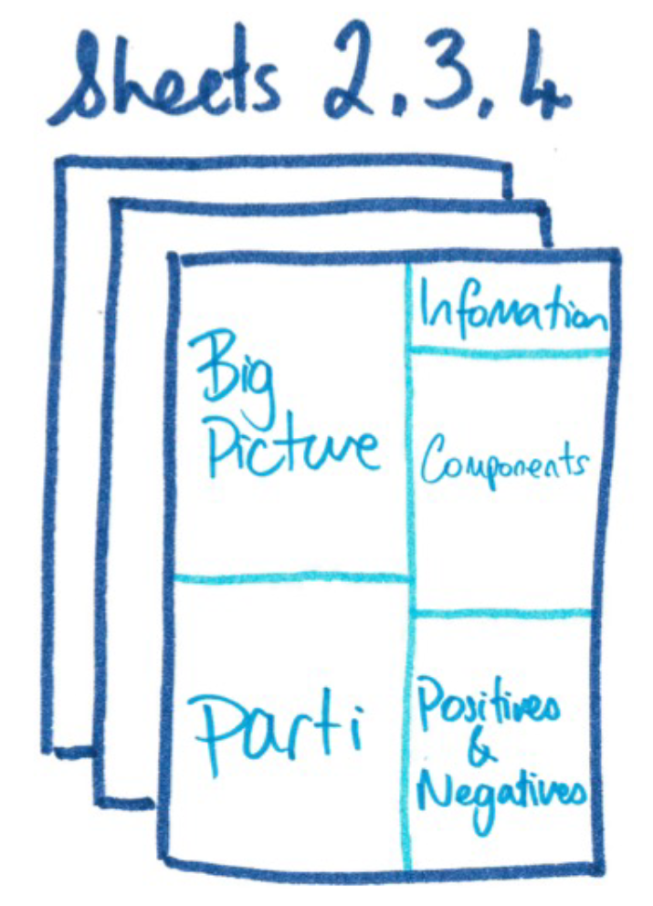
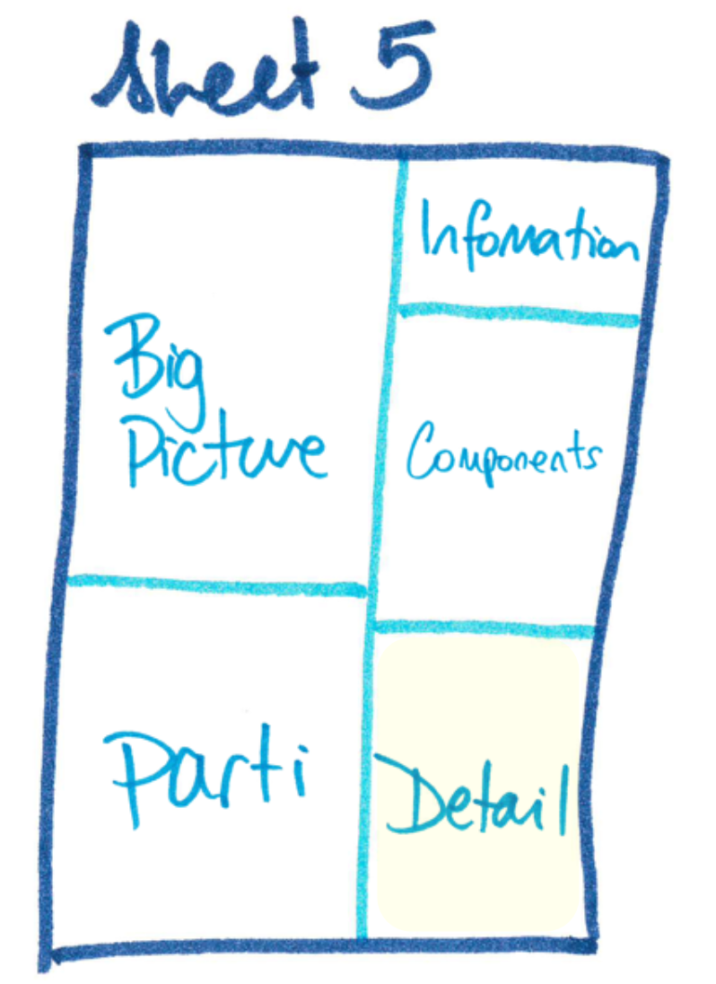
The design process
Five Design-Sheets Methodology
Sheet 1 – Brain Storm
Brain-storm ideas
Focus on quantity to cover many design options
Sheet 2,3,4 – Initial Designs
Three ideas from brain-storming are sketched in greater detail
Aim for three completely different designs
Sheet 5 – Realization Design
Condense ideas down to a single design to be realized
Final design: What gets computed and visualized, and how users interact?
http://fds.design/wp-content/uploads/2015/10/fds-presentation-final-ieeevis2015.pdf

Slide 19
The design process
Nested Model
Solution implementation
Implement components as concrete algorithms
Support parameterization for later adjustment
Consider computational efficiency

Slide 20
The design process
Nested Model
Threats to validity (Where can the design process fail?)
Inaccurate domain characterization: Identified problems are not actual problems of target users, or workflows and working environment deviate from what was understood
Incorrect data and task abstraction: Data does not contain expected information, tasks do not properly address the domain problems
Inadequate design conceptualization: Visual encoding not expressive, interactions not adequate for the environment, unfit analytical procedures
Inefficient solution implementation: Algorithms have too high complexity or are inefficiently implemented, memory footprint too large, network too slow

Slide 21
The design process
Summary
Design process as a cascade of steps
Decisions on the upper levels impact decisions on the lower levels
Mistakes at upper levels can have dire consequences
Issues at lower levels can often be remedied with moderate effort
Actual design can be supported by five design-sheets methodology
Next: How are data actually transformed?

Slide 22
The data transformation process
Visual data analysis is essentially based on the transformation of data to visual representations
The transformation process describes what happens to the data on their way from raw form to images
Most abstractly, the process is a parametric transformation $v$ that takes data $D∈D$ and parameters $P∈P$ as input and generates images $I∈I$ as output:
$$v:D×P→I$$
The question is, what happens inside this arrow?

Slide 23
The data transformation process
Traditionally, the data transformation is described as
Visualization pipeline (Haber & McNabb, 1990)
Visualization reference model (Card et al., 1998)
This is the classic model, which you will find in many text books.
Data Source
Data Tables
Visual Abstractions
Visualization Views
Human
Data Transformations
Visual Mappings
View Transformations
Adapted from Card et al., 1999

Slide 24
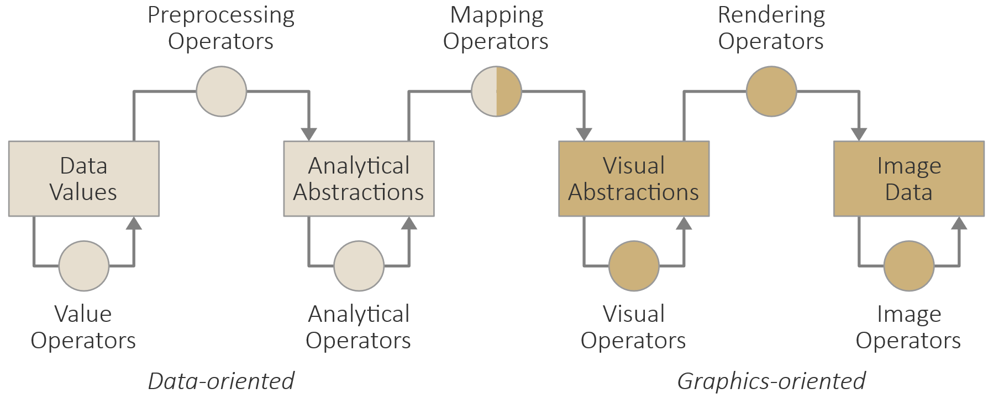
The data transformation process
Chi (2000) describes the data transformation’s internal structure in the data state reference model as a combination of
Stages
Operators
This is a more detailed model, which you will find in several practical applications.

Slide 25
The data transformation process
Stages describe different states that the data may assume
Data values: Raw and unprocessed pieces of information
Analytical abstractions: Well-structured data meaningfully enriched with derived characteristics (e.g., data tables, levels of detail, aggregation, classifications, clusters)
Visual abstractions: Geometric primitives and visual attributes (see next lecture)
Image data: Array(s) of colored pixels
Operators process some input to generate some output
Transformation operators (preprocessing, mapping, rendering) transform the data from one type to another (type of input ≠ type of output)
Stage operators (value, analytical, visual, and image operators) transform the data within the same stage (type of input = type of output)

Slide 26
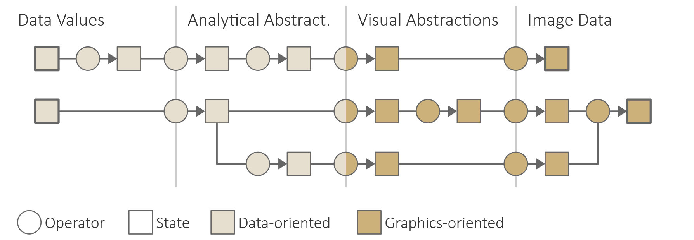
The data transformation process
Visualization pipeline (abstract)

Slide 27
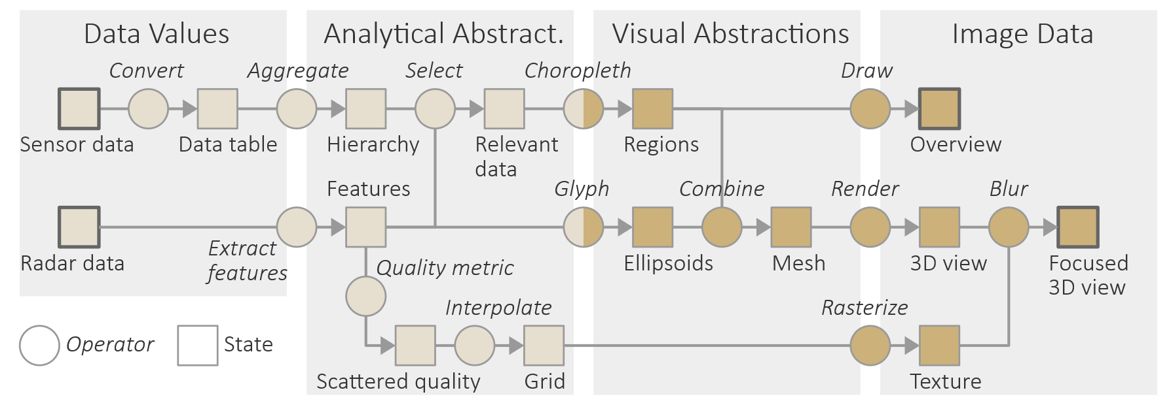
The data transformation process
Visualization pipeline (concrete example)

Slide 28
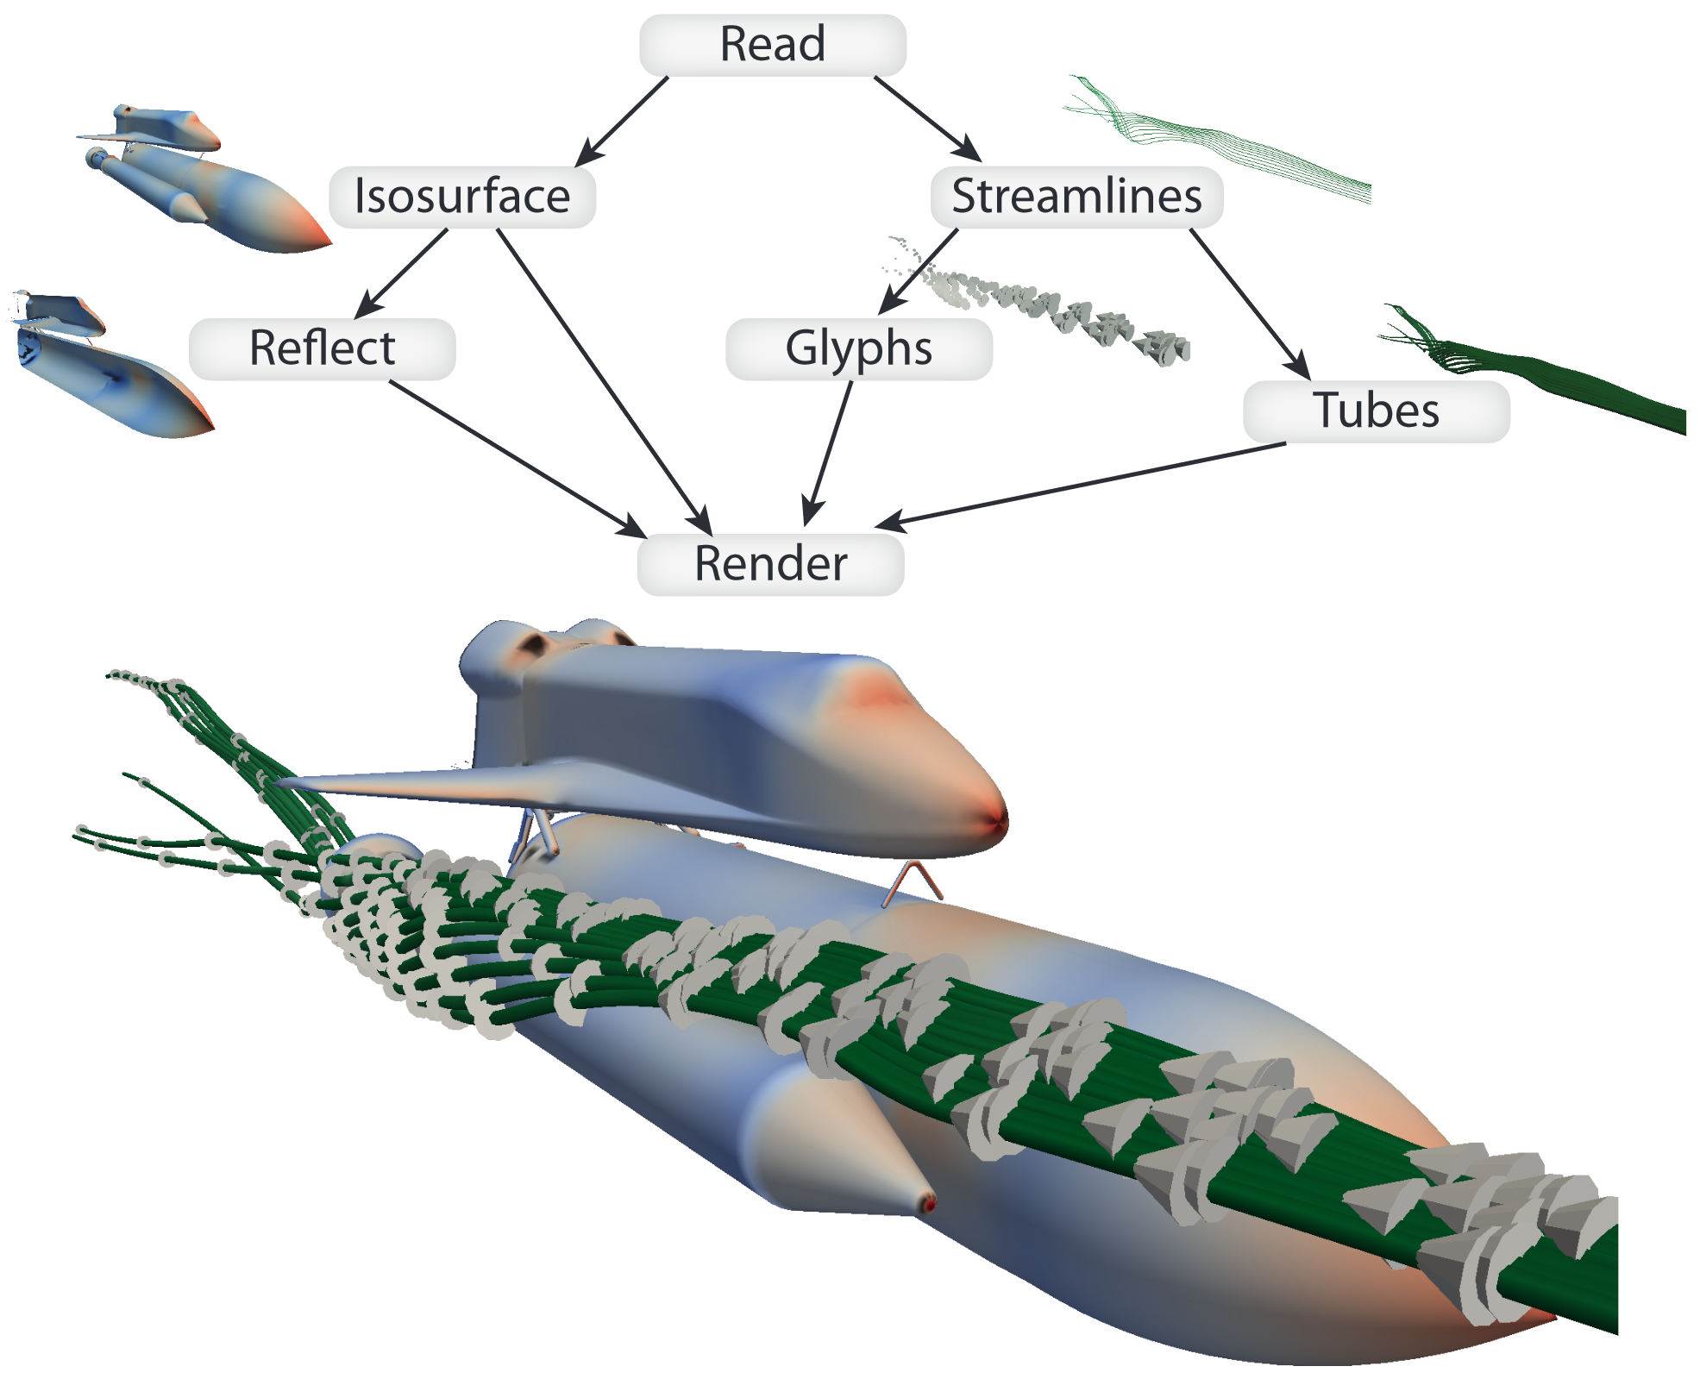
The data transformation process
Pipeline examples in existing software solutions
https://vtk.org
https://www.paraview.org/
Moreland (2013)

Slide 29
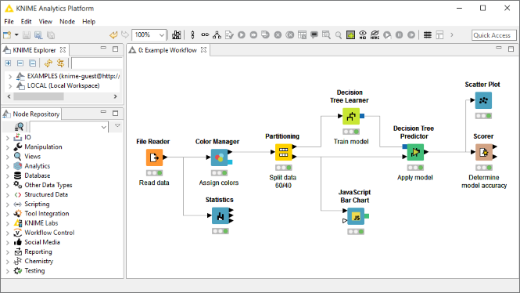
The data transformation process
Pipeline examples in existing software solutions
https://knime.com
https://www.knime.com/

Slide 30
The data transformation process
Summary
Data transformation as parametric mapping $v:D×P→I$
Internals of $v$ described via operators that transform raw data values across several stages to image data
Operators: Preprocessing → mapping → rendering
Stages: Data values → analytical abstractions → visual abstractions → images
Data-oriented operators and stages are concerned with what we can’t see
Graphics-oriented operators and stages are concerned with what we can see
Next: Knowledge generation process

Slide 31
The knowledge generation process
We now know about design and implementation
Next question: How do we actually gain insight into data?
Several models exist to describe how insight and knowledge are produced during interactive visual data analysis
Pirolli and Card (2005): Sense-making model
Van Wijk (2006): Model of visualization
Sacha et al. (2014): Knowledge generation model
All models have in common that they describe some form of loops
Let us next look at the knowledge generation model in detail

Slide 32
The knowledge generation process
Knowledge generation model
Here, we abstract the usually complex analysis solution as a single box.

Slide 33
The knowledge generation process
Knowledge generation model
Three cascading loops of increasing sophistication
Exploration loop
Models the undirected search of the exploratory analysis phase
Starts with observing visual representations in search for interesting findings (e.g., trends, patterns, but also the lack of anything interesting)
Based on findings, users trigger actions that result in adjustments of the data transformation and thus lead to different visual representations
With sufficient findings having been made, the knowledge generation transitions to the verification loop

Slide 34
The knowledge generation process
Knowledge generation model
Three cascading loops of increasing sophistication
Verification loop
Models the confirmatory analysis phase
Starts with describing and explaining the findings to constitute insight that is meaningful w.r.t. the application domain
Based on the generated insight, new hypotheses can be formulated and existing ones be confirmed or rejected
Hypothesis testing usually requires returning to the exploration loop to perform actions in order to collect more findings

Slide 35
The knowledge generation process
Knowledge generation model
Three cascading loops of increasing sophistication
Knowledge-generation loop
Models the final generation of accepted knowledge
Turn accumulated insight into new knowledge of application domain
Usually requires consultation of domain experts to confirm that sufficient evidence exists to trust analysis results
If evidence is not yet sufficient, it is necessary to return to the inner loops of verification and exploration to make more findings and generate additional insight

Slide 36
Assignments
Read about the Five Design-Sheets methodology in Roberts et al.’s (2016) article!

Slide 37
Questions
Which fundamental roles can a person take and which corresponding processes are relevant per role?
Explain the four phases of the nested model of visualization design and validation!
Describe potential threats to validity!
Sketch the basic idea behind the five design-sheets methodology!
What are the key components of the data transformation and how do they form a pipeline?
What are the four data stages of the visualization reference model?
What is the difference between transformation operators and stage operators?
Give an example for each, a preprocessing, a mapping, and a rendering operator!
Explain the knowledge-generation model!

